Slide 1

ANALYSIS AND SUMMARIZATION OF LEGAL CASE REPORTS
Eseoghene Emuraye • Sharmin Kantharia • Hemanth Koganti

Slide 2
Introduction
Legal documents have extensive theory making them difficult to study and analyze quickly.
Hence, it is important to find easier ways to summarize large collection of legal texts.
Using catchphrases, tokenized sentences and citations present in a legal document, we can analyze legal case reports through summarization.
Such analysis can present insights on the different types of cases, their similarities and their differences.

Slide 3
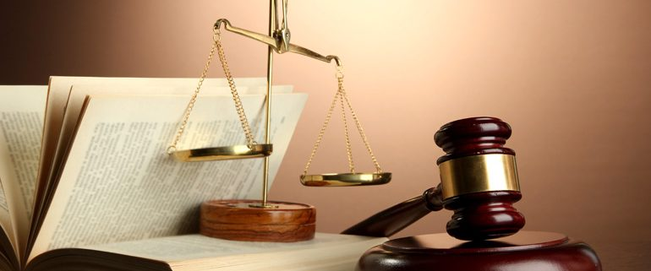

Objectives
GOAL
Citations-based clustering and summarization of legal case reports to increase the efficiency with which legal cases are analyzed.
Main Objectives:
To cluster legal case reports based on similar citations.
To summarize case reports in each cluster to increase efficiency with which legal cases are analyzed.
Evaluate the accuracy of the generated summaries.

Slide 4
Data Source
Name – Legal Case Reports Dataset
Source – UCI Machine Learning Repository (Originally from the FCA website)
Number of Cases – 3890
The dataset contains Australian legal cases from the Federal Court of Australia (FCA) [2006 – 2009]
NOTE
The case reports analyzed in this project are taken from the Federal Court of Australia. While the format and legal proceedings may vary in each country, the techniques suggested can be applied to legal documents in the United States, given they have citations included in them.

Slide 5
Methodology
Text Preprocessing
Citation-based Clustering
Summarization
Evaluation
Input: Case reports
Output: Catchphrases, Sentences and Citations
Input: Extracted Citations
Output: Clusters of extracted sentences and catchphrases of case reports
Input: Clusters and Extracted Catchphrases
Output: Generated summaries per cluster
Input: Machine-generated summaries and Extracted Catchphrases
Output: Recall and Precision metric values with respect to ROUGE-N

Slide 6

Text Preprocessing
Extract the following components from the raw case reports and citations files
Catchphrases
Sentences
Citations

Slide 7
Catchphrase Extraction
Original Text
Extracted Catchphrases
Sentence Extraction
Original Text
Extracted Sentences

Slide 8
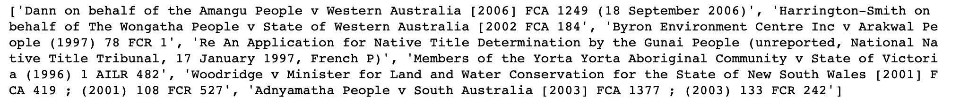
Citations Extraction
Original Text
Extracted Citations

Slide 9
Citations-based Clustering
Directed graph data structure containing extracted citations is generated
Infomap algorithm is run on the graph
Clusters containing the extracted catchphrases and sentences are generated

Slide 10
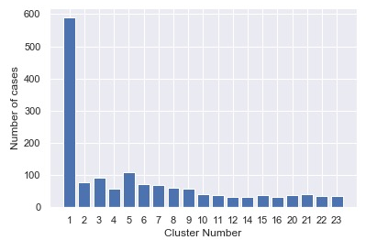
Clustering
Out of the total 287 clusters generated, we choose to work with those where the number of cases in each cluster is greater than or equal to 10. We had 48 such clusters.
The plot here represents the top 23 clusters, with highest number of cases in them.

Slide 11
Cluster-wise Summarization
Cases in each cluster are merged to form a large body of text.
Summaries are generated for each cluster using Text Rank Algorithm (Gensim package)

Slide 12
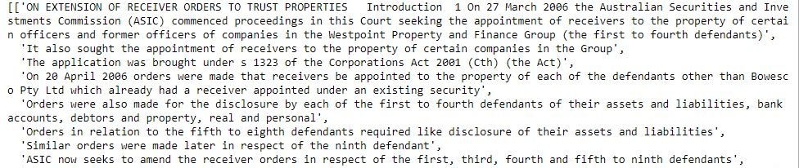
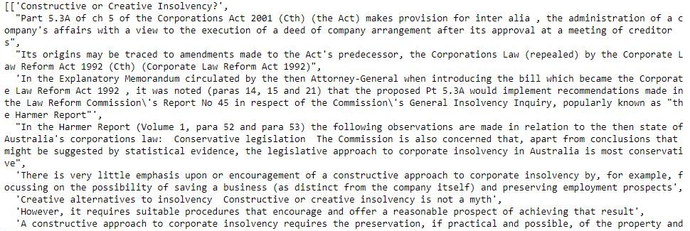
Summarization
Original Text
Generated Summary

Slide 13
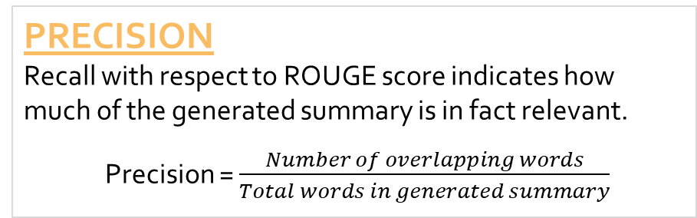
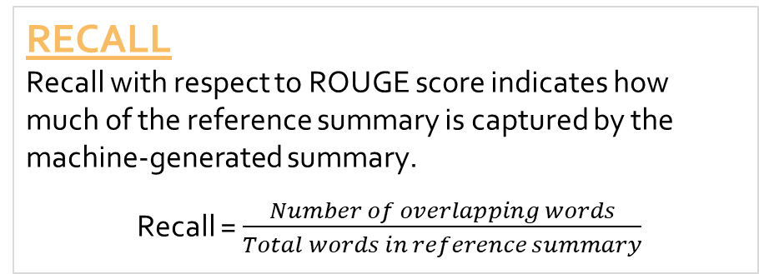
Evaluation
We evaluate the accuracy of the summaries generated, using Recall-Oriented Understudy for Gisting Evaluation or ROUGE-N metric. Here we keep in mind the 2 types of entities (summaries) used in the evaluation –
Generated Summary – machine-generated summary
Reference Summary – extracted catchphrases for each case
The following evaluation metrics are calculated –
RECALL
Recall with respect to ROUGE score indicates how much of the reference summary is captured by the machine-generated summary.
Recall = $\frac{Number of overlapping words}{Total words in reference summary}$
PRECISION
Recall with respect to ROUGE score indicates how much of the generated summary is in fact relevant.
Precision = $\frac{Number of overlapping words}{Total words in generated summary}$

Slide 14
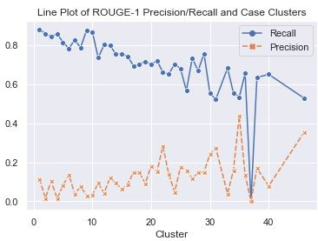
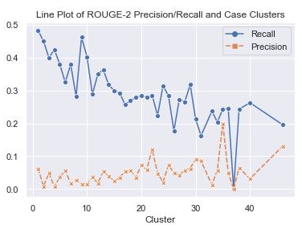
Evaluation
Figure 1: Recall and Precision for ROGUE-1
Figure 2: Recall and Precision for ROGUE-2
In both plots, we can observe that the generated summaries capture a good amount of the reference summaries judging from the observed values of recall across all clusters ( > 0.5). However, the generated summaries captures some of the text that are not relevant, judging from the observed values of precision across all clusters ( < 0.3).

Slide 15
Challenges
The documents present in some clusters were large and thereby increased the computation time.
Converting clustered cases to the appropriate data type to fit in the summarizer in the gensim package was a hindrance.
It was difficult to ascertain the reason why cluster 37, despite having 16 cases, did not generate any summary when fed into the summarizer.

Slide 16
Conclusion
A great deal of work has been done to generate the summaries for each cluster. Judging by an overall recall score greater than 0.5, it can be understood that the extractive summarization techniques, give a good representation of cases based on similar citations. Through the technologies implemented in this project, it can be understood that given citations, we can generate clusters and analyze the texts in each cluster. Hence, similar concepts can be applied to legal cases in any constitution.

Slide 17
Future Work
Legal texts have characteristics different from news articles and other texts, specifically in the vocabulary and ambiguity.
Given more time, it would be interesting to identify the topics labels present in different clusters of legal case reports by applying the Latent Dirichlet Allocation (LDA) algorithm to generate different topic labels per cluster allowing comparison across clusters to check for similarities or differences.
There is also a possibility to explore and apply abstractive summarization techniques to generate summaries for the same dataset and compare the results of the 2 summarizations methods.
Legal jargon can also be extracted for better understanding the language of a case, using keywords generated in through the TextRank algorithm.

